Slide 1


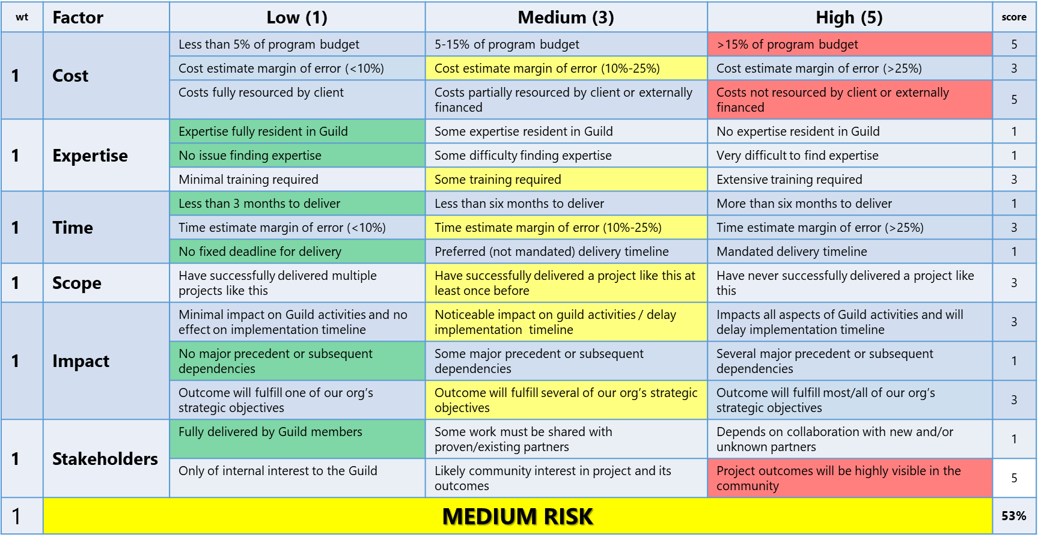




PROJECT CONCEPT: VITAL POINT PERSONAS
Client | Vital Point AI
Sponsor | Aaron Luhning
Start | 16 Dec 2020
Delivery | 10 Jan 2021
Est Cost
References
A. 3Box (Ethereum)
What is the opportunity?
Why does it matter?
People have one core identity (true self) and manage multiple variations, providing the image of themselves that they want to portray in any given environment or circumstance. The image or personality one presents in public or other specific setting – as opposed to their true self – is a persona.
On and offline, people interact with multiple groups across a variety of domains. The communities used for these interactions usually request that members create a profile as a means of establishing their identity in the community. Because these platforms are not interconnected, people construct and reconstruct member profiles trusting centralized communities to protect it and use it properly. Too often their data is neither protected nor used properly subjecting people to unnecessary risk.
Similar to how 3Box (ref A) allows people to build a profile on Ethereum that is used across multiple Dapps, Personas can provide users with the ability to securely manage their data in a decentralized manner and more efficiently use it to build unique personas that they can then choose from when interacting with communities.
Solves a Common Problem. Nearly every on/offline community requests information from their members to establish member identity and foster community interaction. It may be as simple as a username or as extensive as a full psychological/aptitude assessment or more.
Create once, use anywhere personas cut down on individual work (more efficient) while also protecting people by ensuring they are only providing the necessary data for the image they want to portray.
Data Sovereignty. Built on NEAR and using IPFS for data storage means the individual can maintain ownership of their data*. Applications “read and display” vice “store and display” individual data.
Core Community Component. Lowers barrier of entry for new communities by reducing some of the technical burden required to implement profile/login capability. Providing universal login and selective profile capabilities with built in economics speeds adoption of the NEAR ecosystem and community adoption by prospective members given ease of joining and immediately interacting with members of the community.
Risk Profile
(Annex A)
*Note: won’t prevent digital copies
…must…
…might…
…won’t…
be hierarchical – provide a master persona (true self) from which unlimited additional personas are created and extended (customized)
allow the master persona to create persona structures that match the environment in which they are intended for use
maintain control of the member’s data and intelligently supply applications with what is needed (i.e., does it need to know exactly where you live and what your age is, or does it just need to know that you are a citizen of the country and old enough to vote)
provide seamless integration for applications on NEAR to incorporate personas into their applications (including brandable login through the master persona account – using the NEAR wallet recovery capability)
serve as an attestation/verification service for critical information
be a foundation for providing additional data that is shared across applications
look to extend beyond NEAR to other chains (use of bridges)
document the entire project development/management process as a course for Vital Point Guild members
prevent digital copies of data that is provided (nothing stopping an application from replicating data provided to it). Can potentially be mitigated through terms of use that application agree to under consequence of legal measures
The Solution
Project Management Annexes
Risk Profile I. Project Status
Project Charter
Stakeholder Register and Communications Plan
Work Breakdown Structure
Project Schedule
Project Budget
Issues Log
Change Log
1/1
Powering Augmented Cognition

